Slide 1
Uphill Battle Of Mobile Visual Regression
Dmitry Vinnik, @DmitryVinnik
Lead Software Engineer, Salesforce

Slide 2
Goals
What are our goals?
Visual Testing (VT):
What, Why, How and When
New Perspective on Test Pyramid
Find VT Tool For Your Team

Slide 3

Target Platforms
Target Platforms?
iOS
Responsive Apps
Android
Hybrid Apps
Notes:
Credit: Designed by Freepik, https://www.freepik.com/free-vector/technological-devices-design_953322.htm

Slide 4
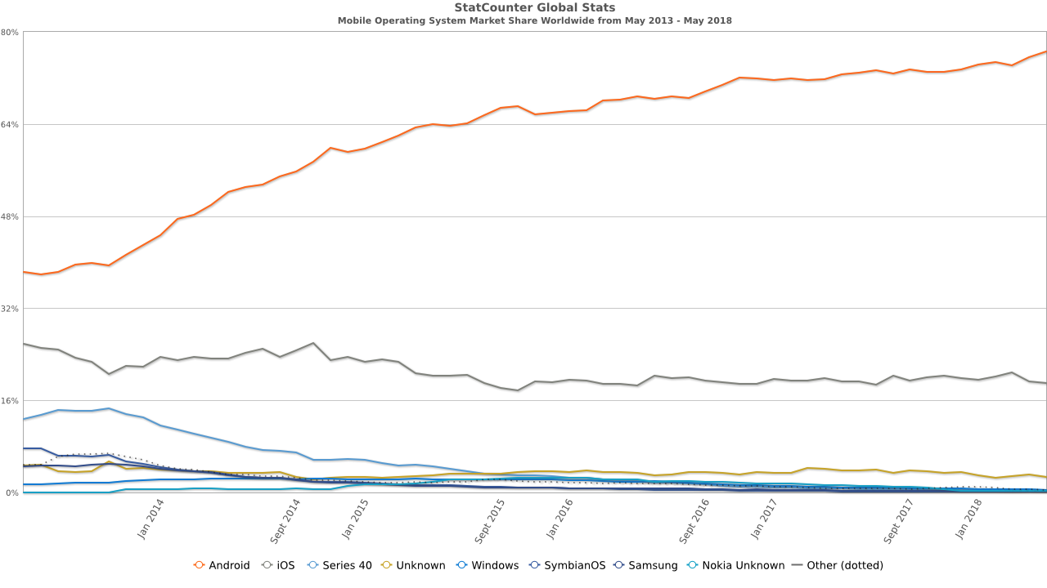
Let’s see some data
But “Mobile” is so broad
Android
iOS
Notes:
Data:
Android: 76.53%
iOS: 18.97%
Windows: 0.49%
Reference: http://gs.statcounter.com/os-market-share/mobile/worldwide/#monthly-201305-201805

Slide 5
From the Top Level
How do we organize
QA Effort?

Slide 6
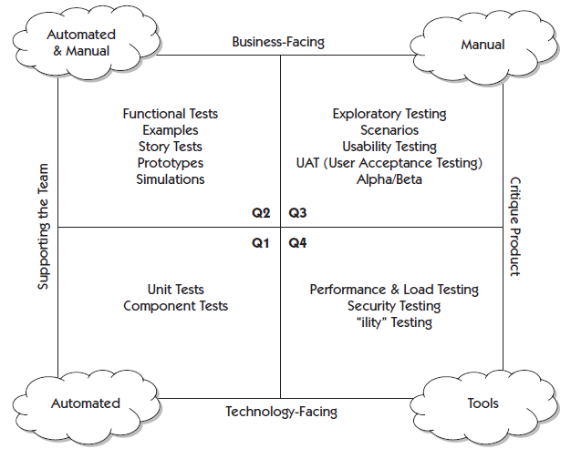
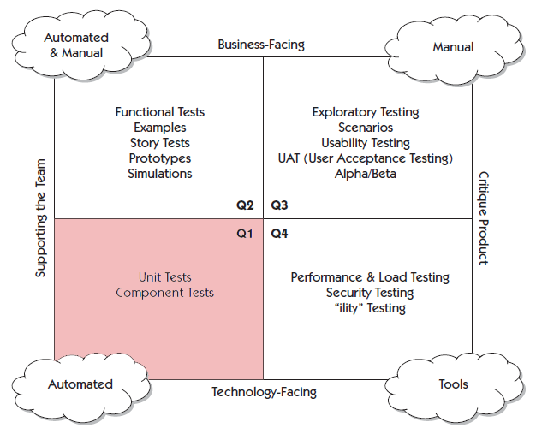
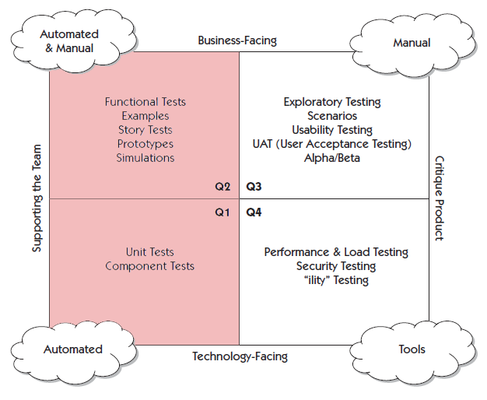
Agile Testing Quadrants
Testing Quadrants
From “Agile Testing: A Practical Guide for Testers and Agile Teams”
by Lisa Crispin and Janet Gregory

Slide 7
How do we usually test?
Let’s go in more details

Slide 8
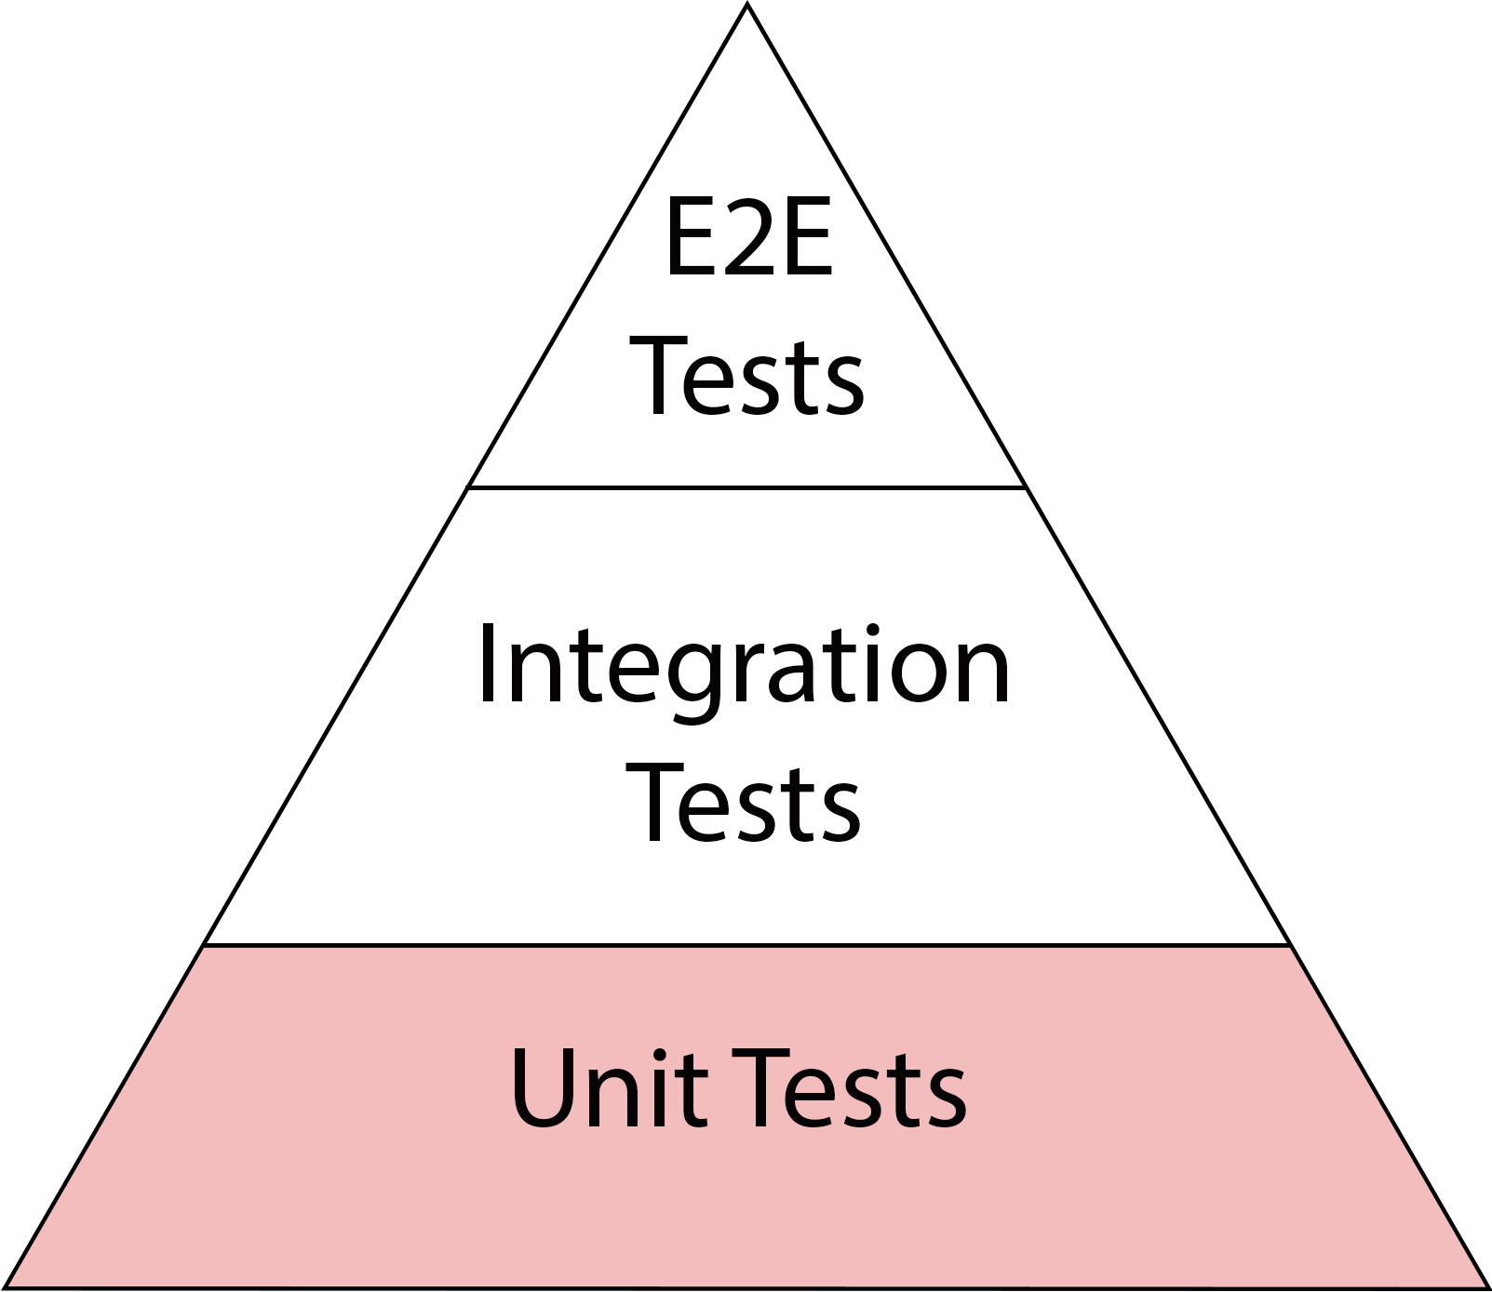
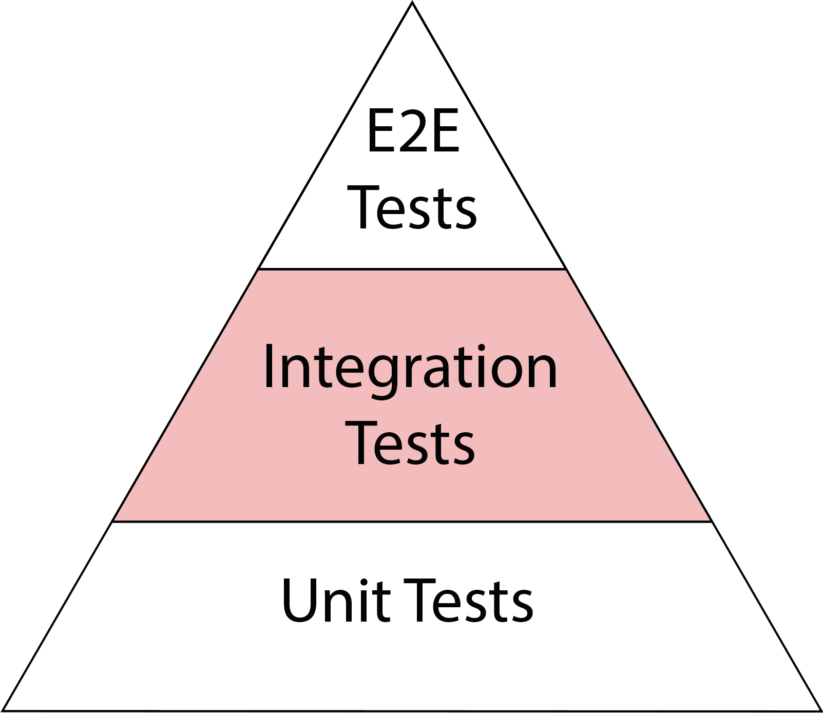
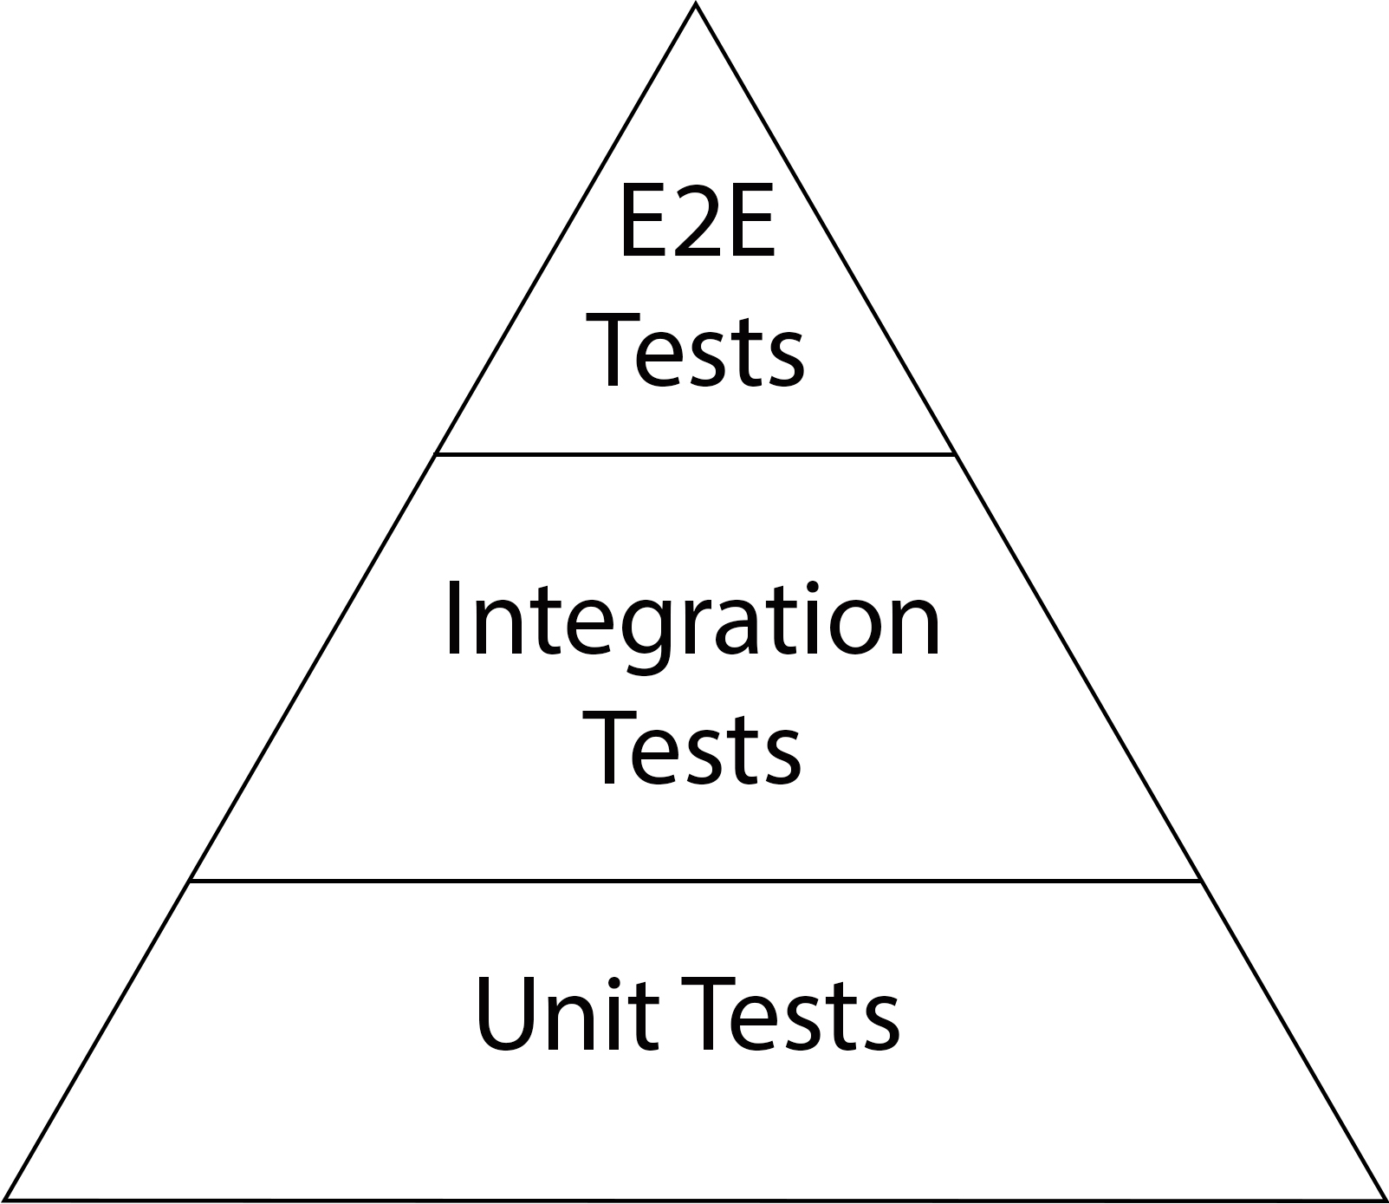
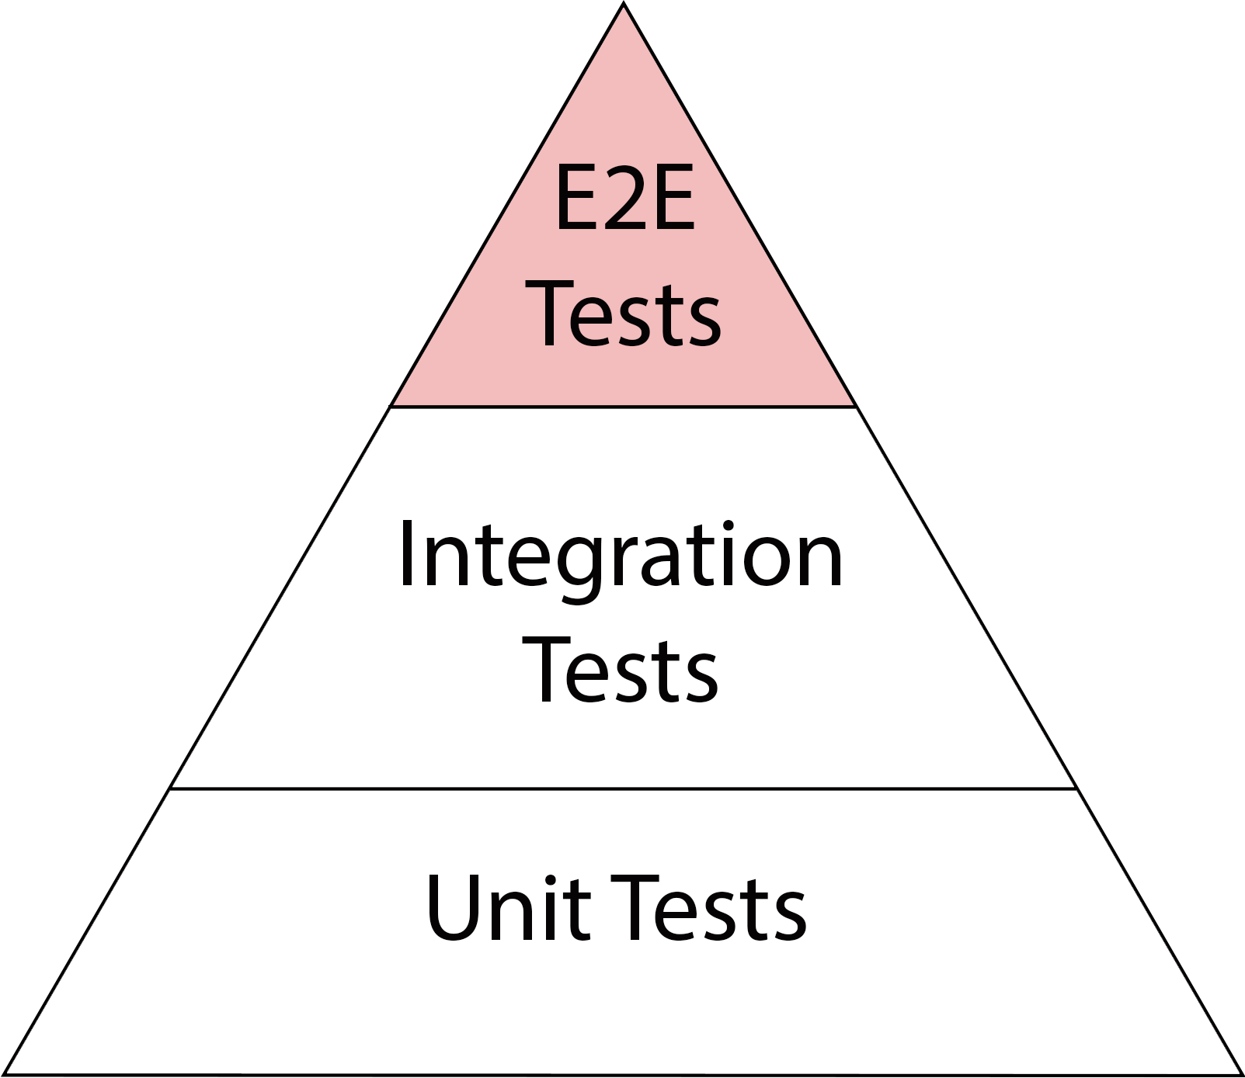
Test Pyramid
↑ Fidelity
↓ Speed
↑ Cost
↓ Fidelity
↑ Speed
↓ Cost

Slide 9
Let’s try get more practical

Slide 10
Is anyone thirsty?

Slide 11


Drinking Glass
Test Pyramid & Drinking Glass
Pour
Drink
Unit
Integration
E2E

Slide 12
Are we done?
Not really...

Slide 13


Drinking Glass
Test Pyramid & Drinking Glass
Pour
Drink
Unit
Integration
E2E

Slide 14
What are we missing?
What are we missing?
Same Functionally
UX
Different Visually
UX

Slide 15
Visual Testing
Visual Content
Visual
Animation
Page Layout
Responsive Design

Slide 16
Functional
Manual Testing
Visual
Manual Testing
is Nearly Impossible
is Difficult

Slide 17
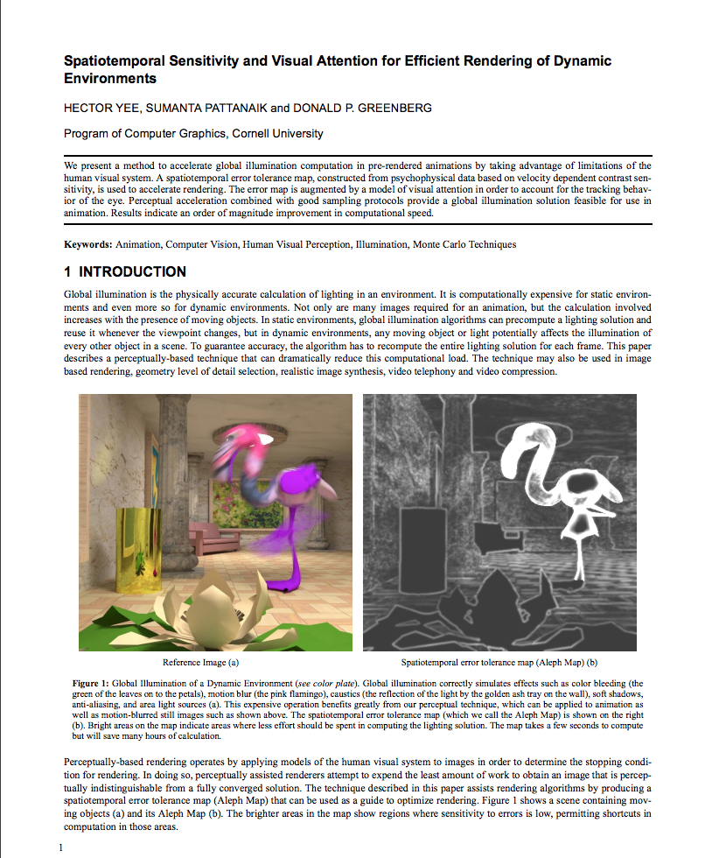
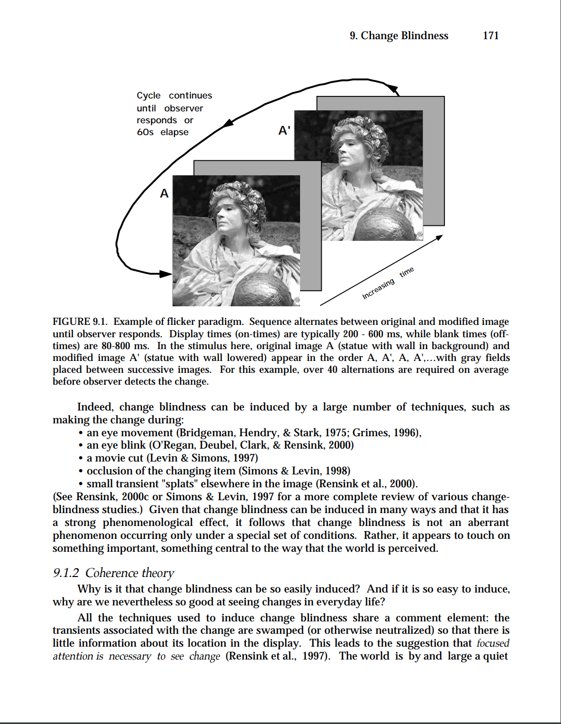
A Little Bit of Science
A Little Bit of Science
Notes:
References:
Spatiotemporal Sensitivity and Visual Attention for Efficient Rendering of Dynamic Environments, http://pdiff.sourceforge.net/ypg01.pdf
Change Blindness: Implications for the Nature of Visual Attention, https://www2.psych.ubc.ca/~rensink/publications/download/Vision&Attention-RR.pdf

Slide 18
Visual Testing
requires Automation
Conclusion?

Slide 19
Where does it fit on
Test Pyramid?
But!

Slide 20
On Every Level!

Slide 21
Test Pyramid
↑ Fidelity
↓ Speed
↑ Cost
↓ Fidelity
↑ Speed
↓ Cost

Slide 22
Uphill Battle
Remember the Title?
Uphill Battle Of Mobile Visual Regression

Slide 23
Test Mountain
Test Pyramid
Test Hill

Slide 24
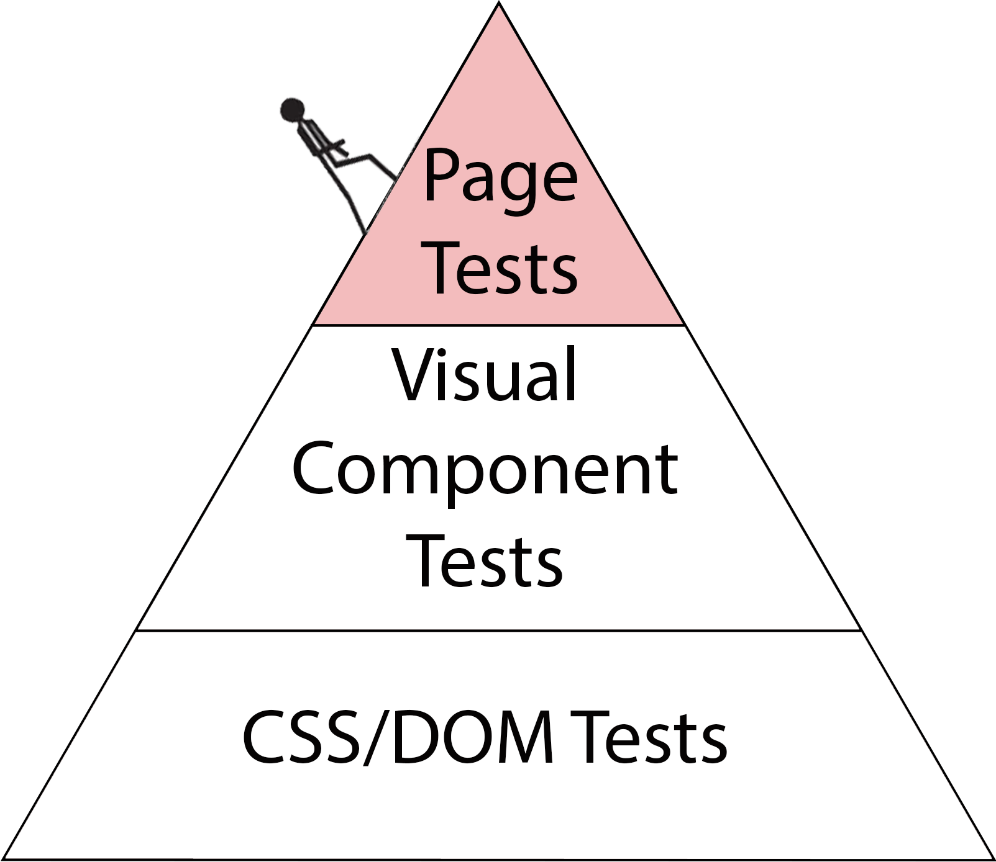
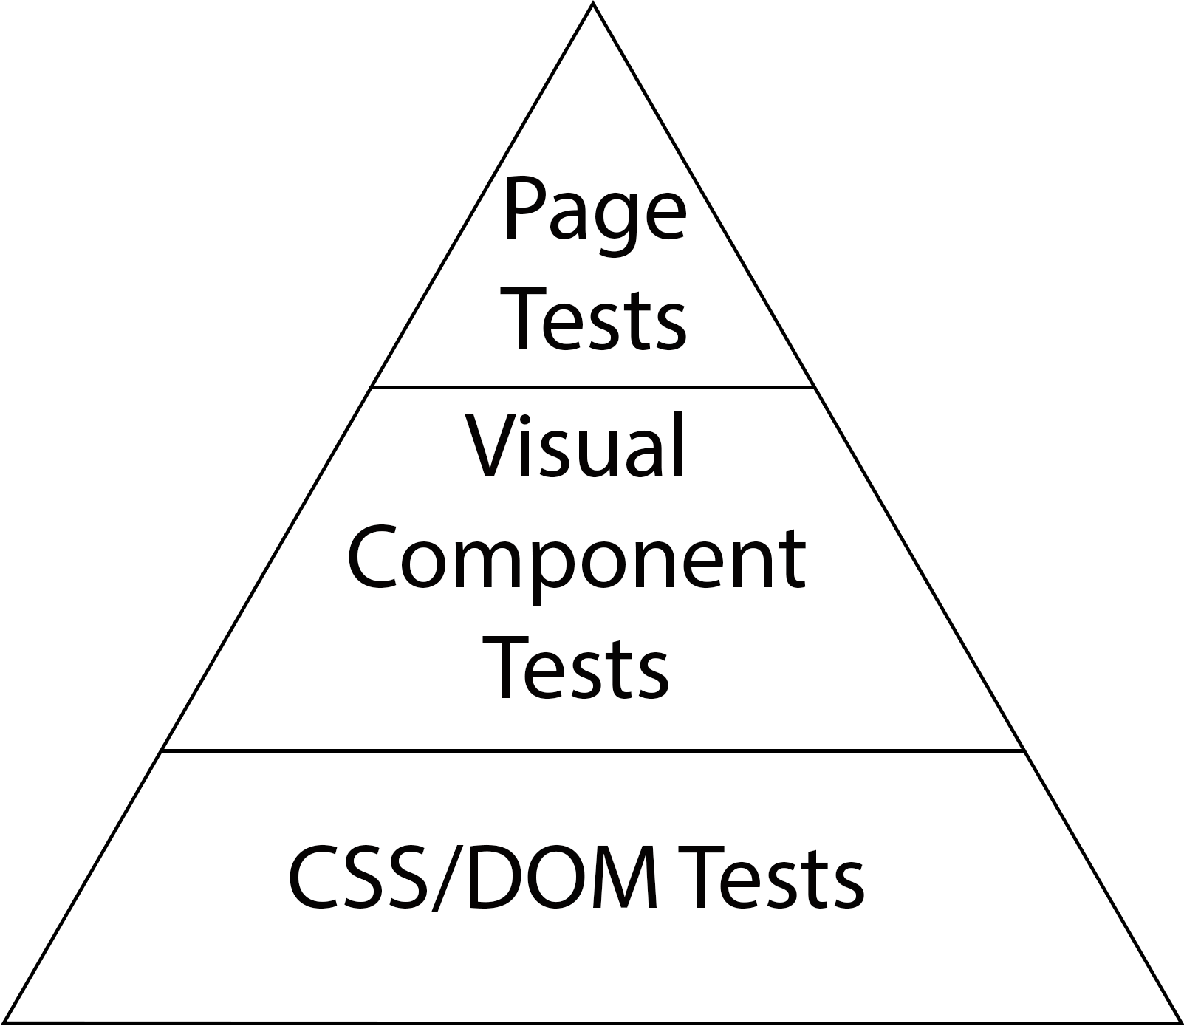
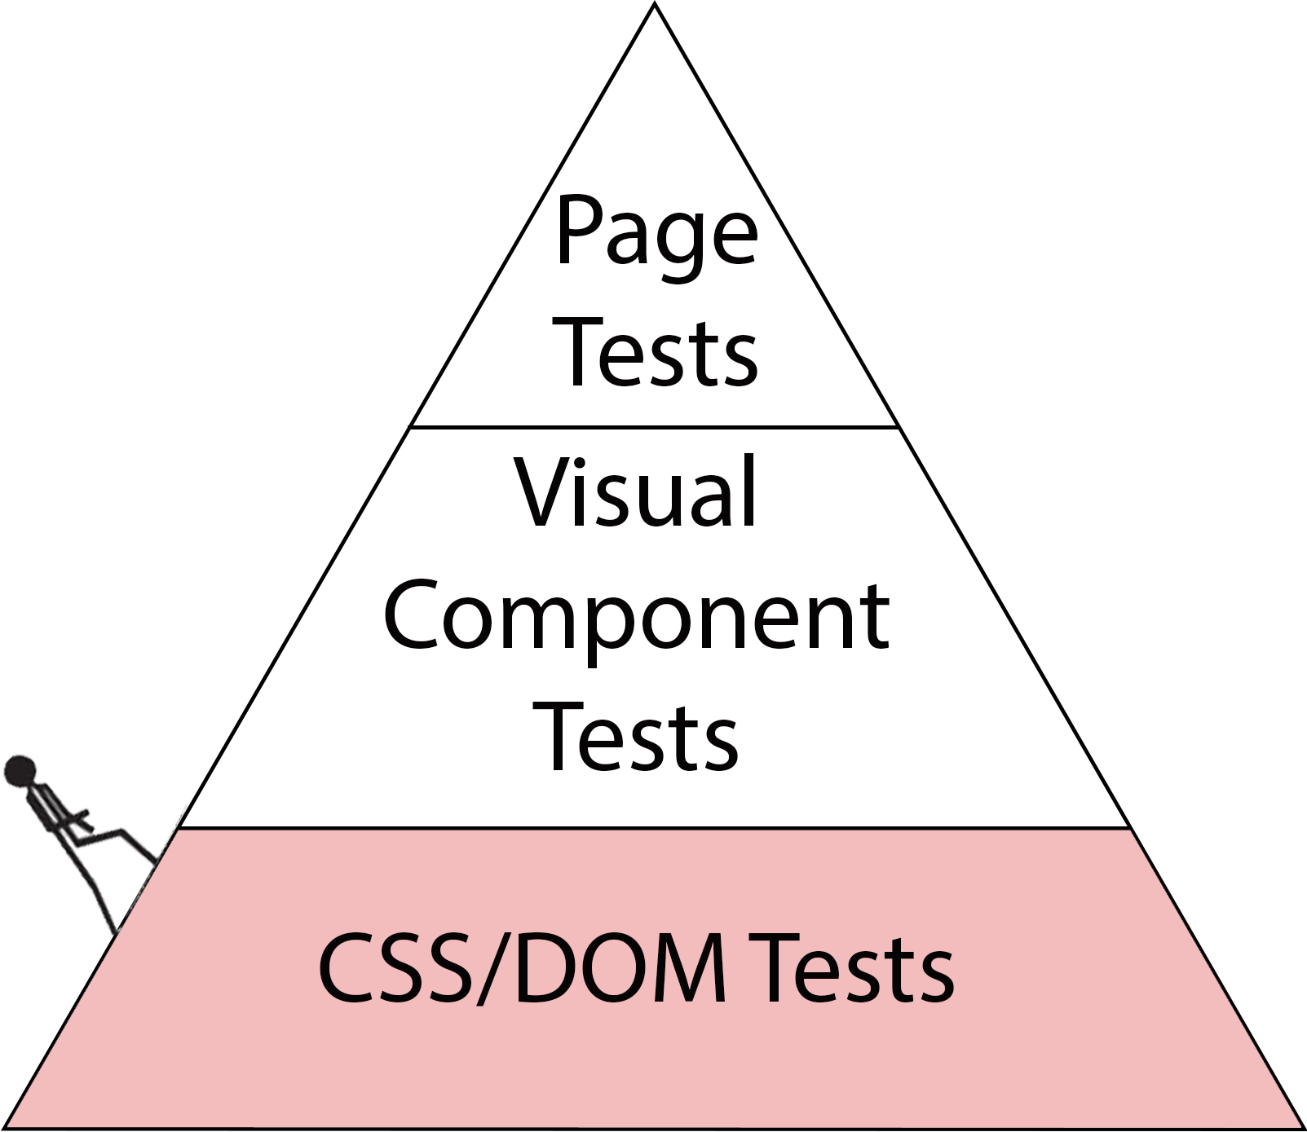
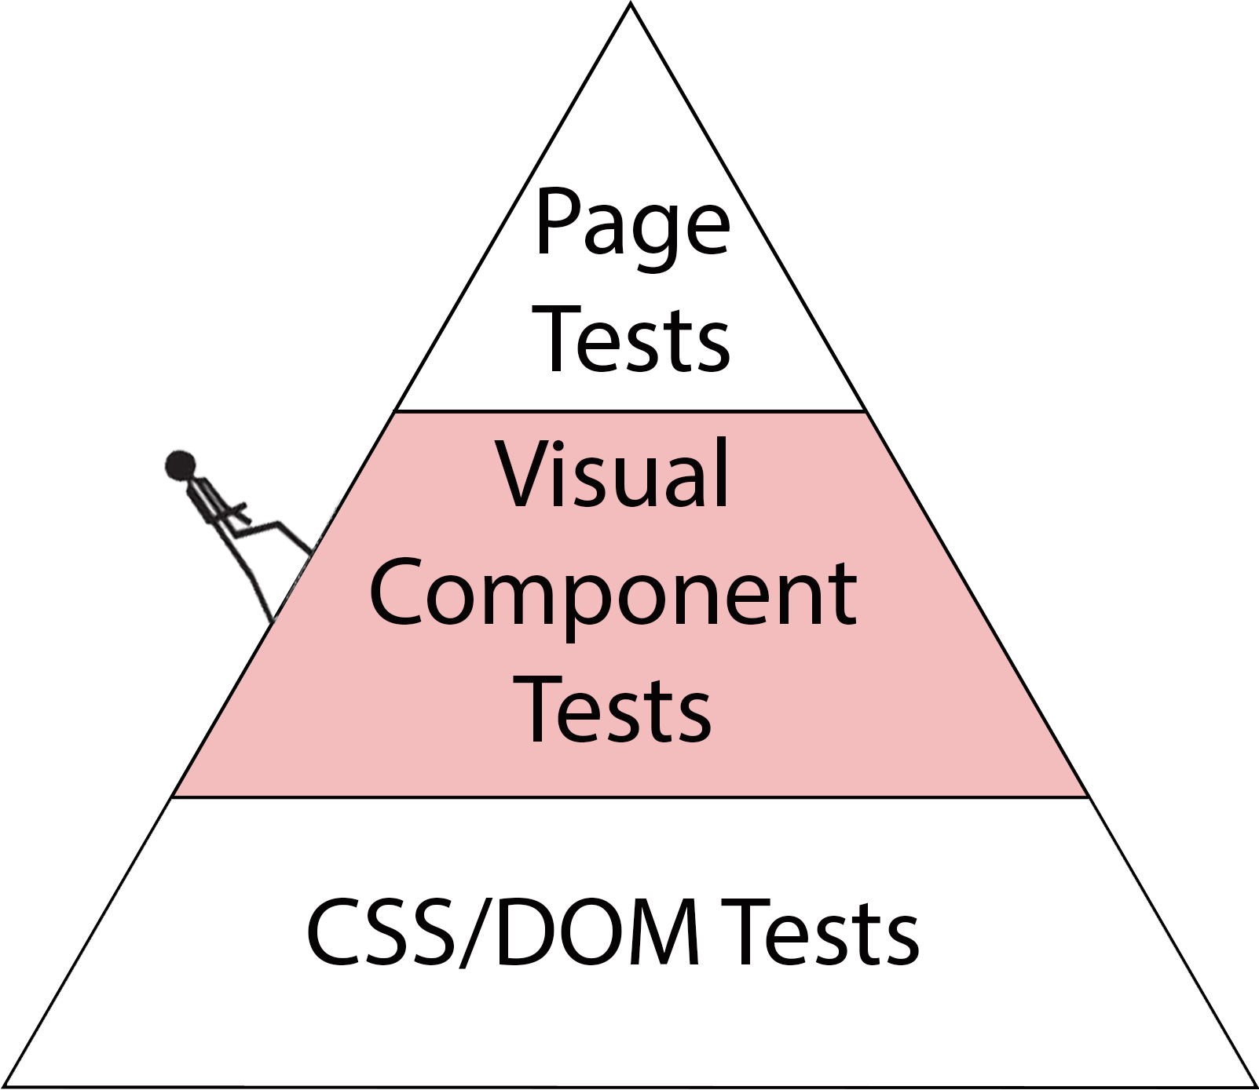
Visual Test Mountain
Visual Test Mountain
↑ Fidelity
↓ Speed
↑ Cost
↓ Fidelity
↑ Speed
↓ Cost

Slide 25
Let’s Start Our Climb!

Slide 26
CSS/DOM Tests

Slide 27
Testing Demos
Responsive App
Hybrid App
Android
iOS
Android
iOS

Slide 28
Demo Time:
Snapshot Testing

Slide 29
Is it enough?
Let me show you why
No!

Slide 30
Quick Glance:
Responsive Design
in Action

Slide 31
Solution?

Slide 32
Visual Component Testing

Slide 33
Let’s Step Back First

Slide 34
Component Driven Development
Reusable
Encapsulated
Composable
Semantic

Slide 35
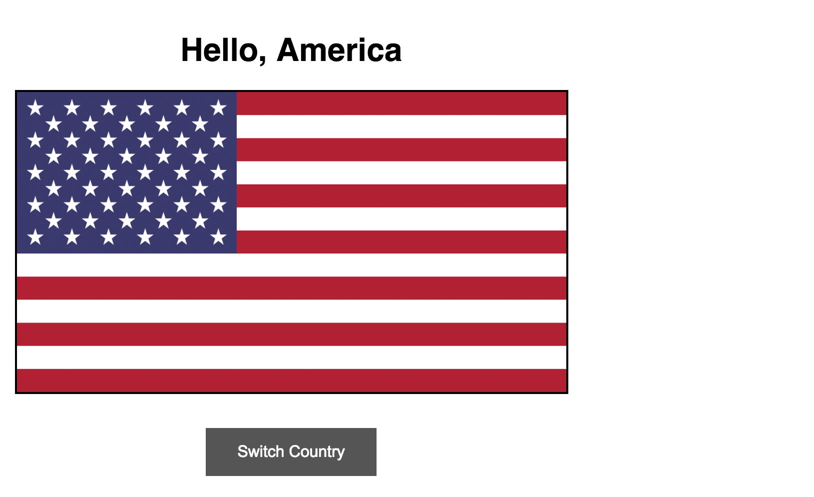
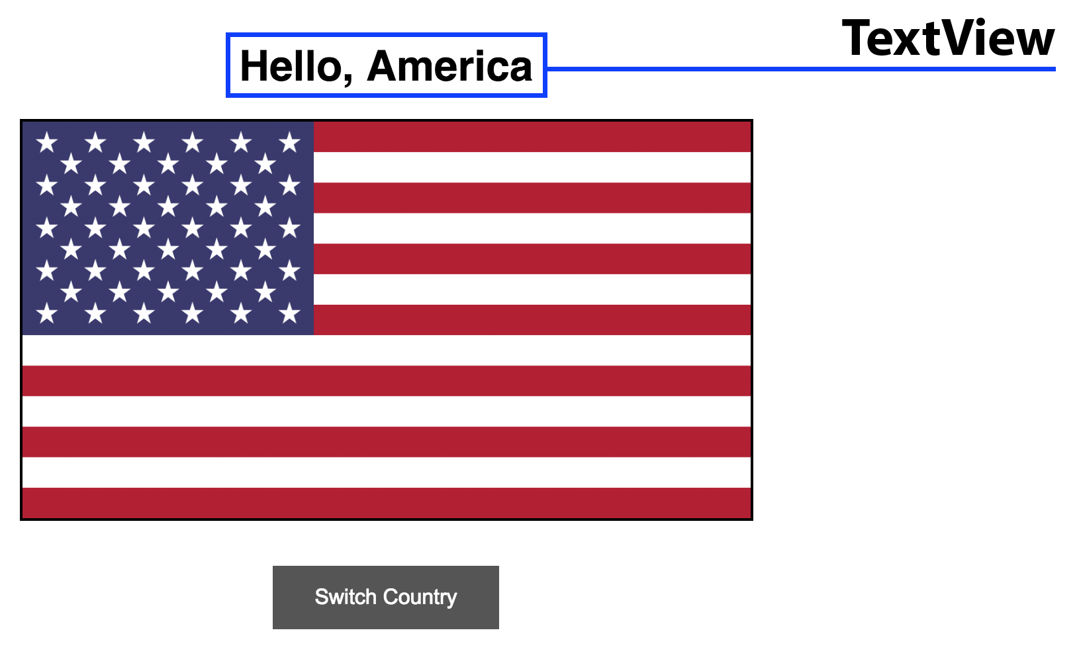
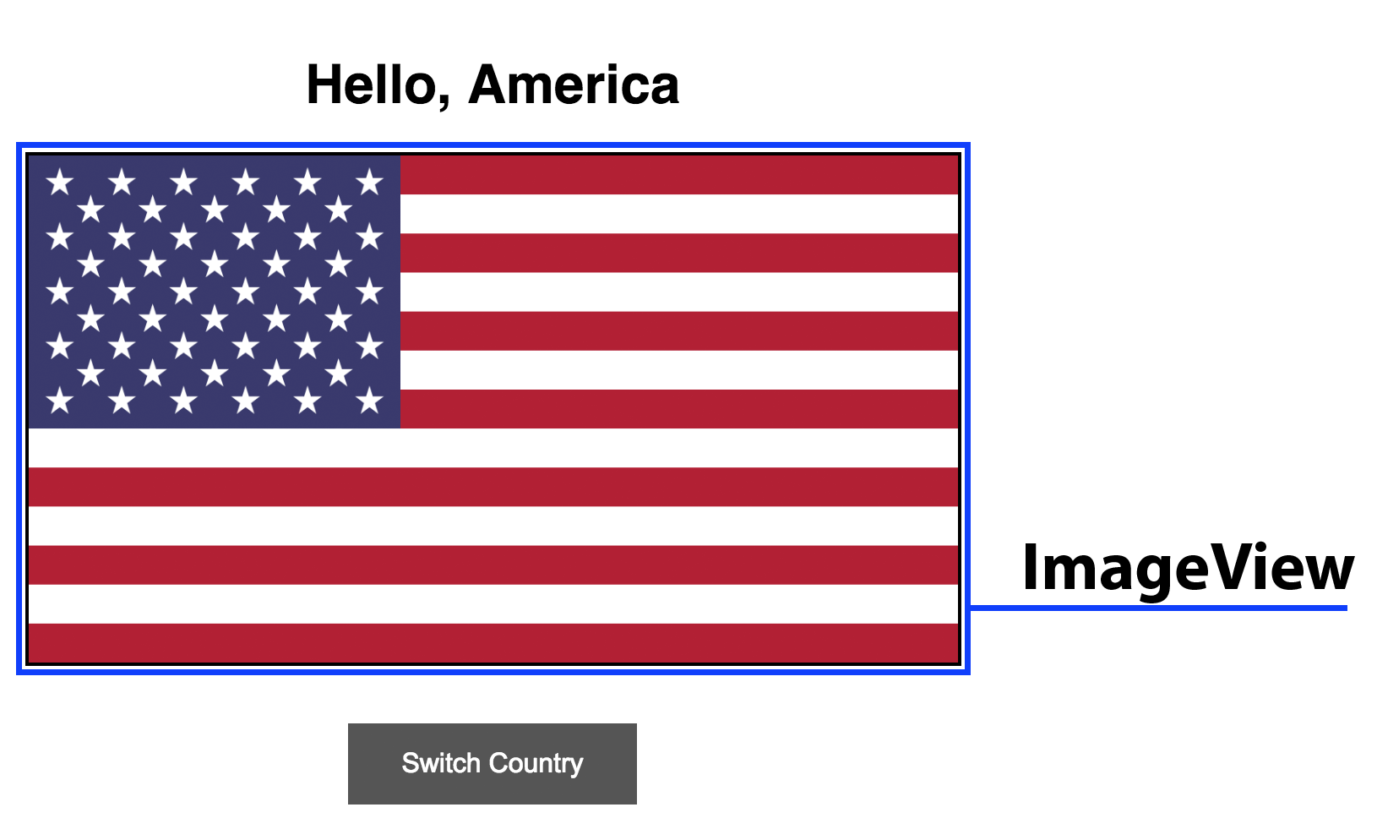
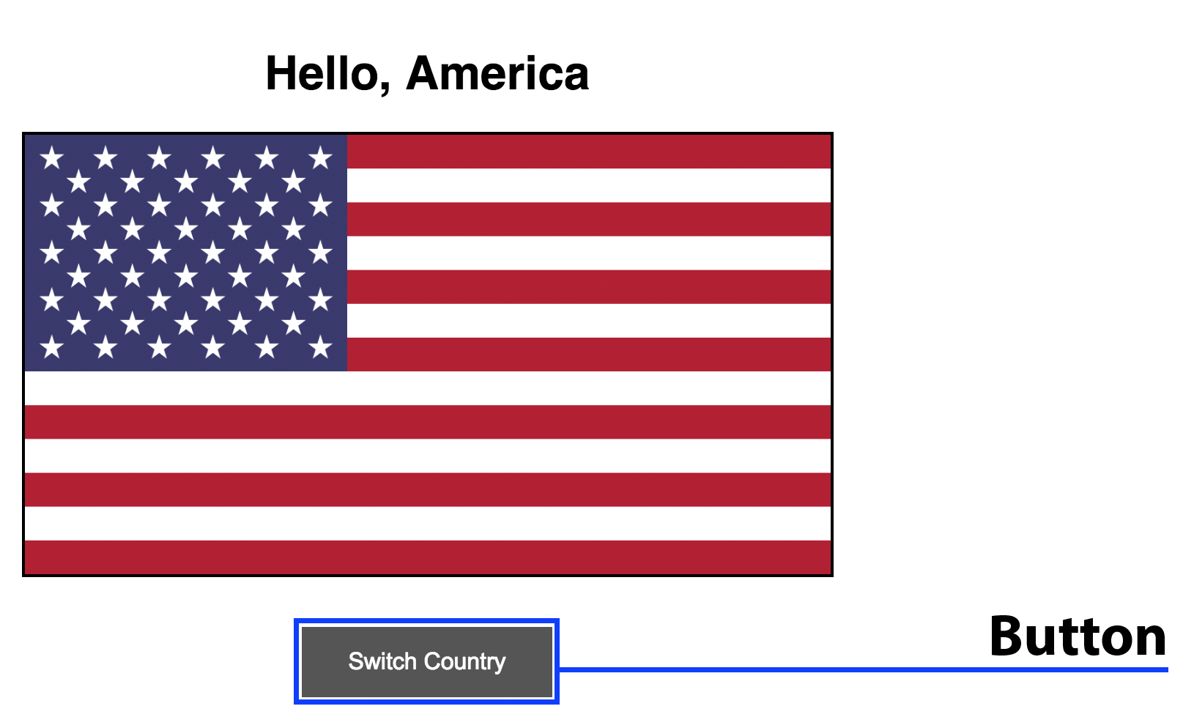
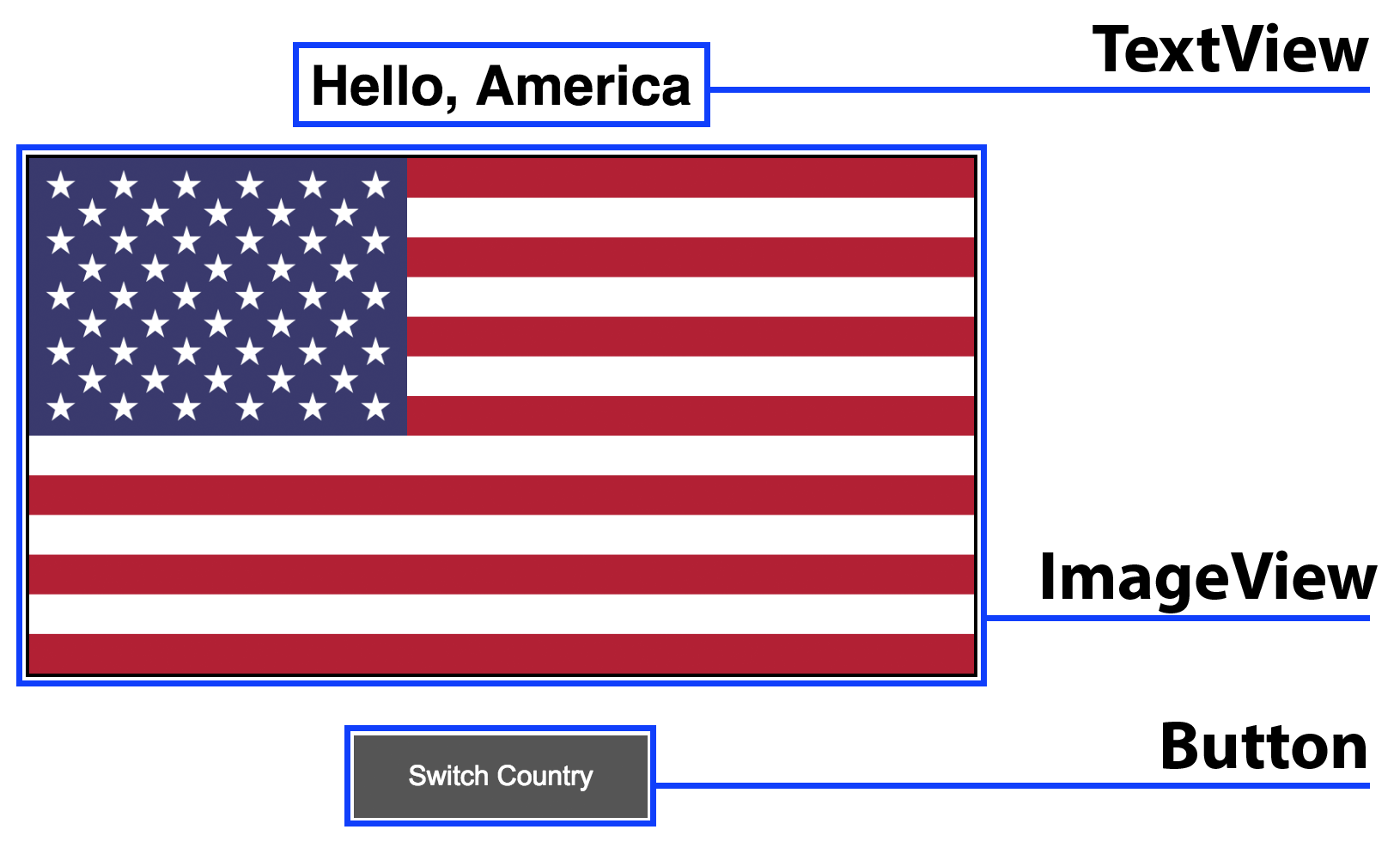
CDD in Practice

Slide 36
Storybook
Library
Testing Ground
Styleguide
IDE

Slide 37
Quick Glance:
Storybook
Notes:
See http://airbnb.io/react-dates

Slide 38
Visual Component Testing

Slide 39
Testing Demos
Responsive App
Hybrid App
Android
iOS

Slide 40
Screenshot Testing
View
Loader
Action
Driver
Comparison
Driver

Slide 41



PhantomCSS

Slide 42
Demo Time:
PhantomCSS

Slide 43



BackstopJS

Slide 44
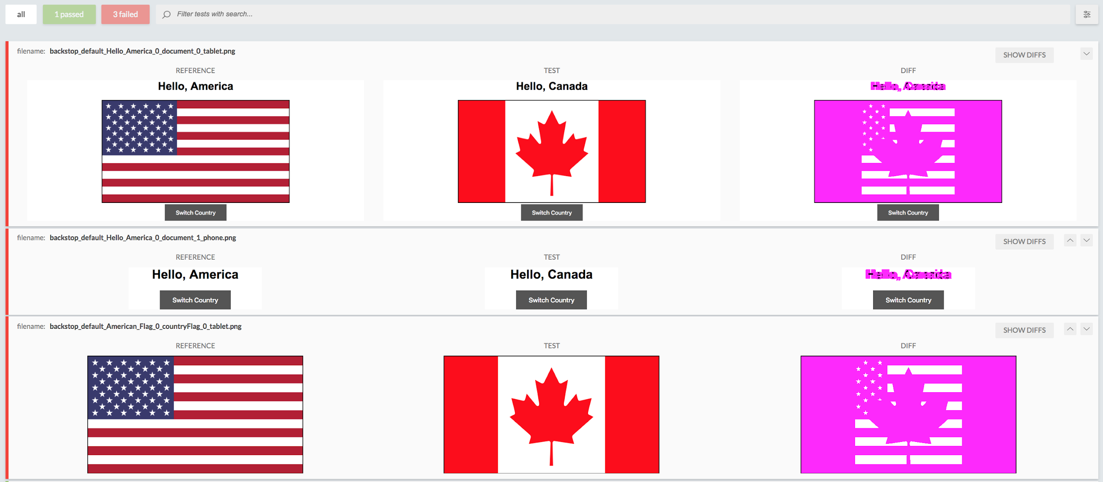
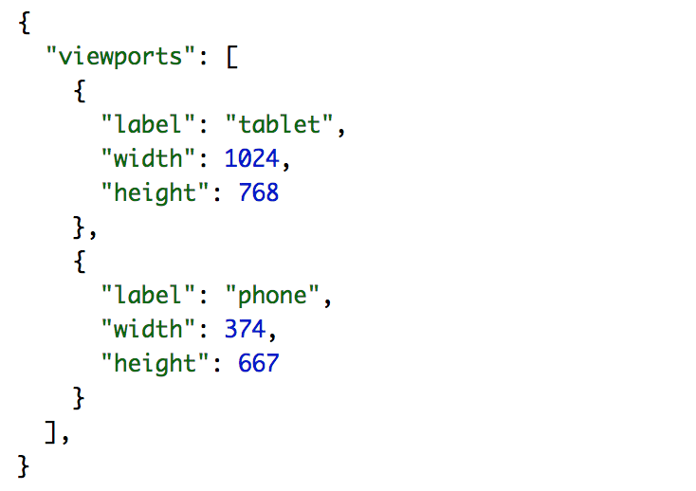
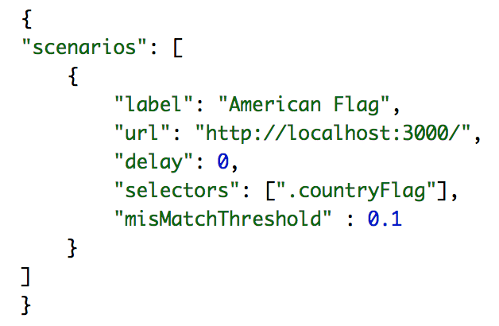

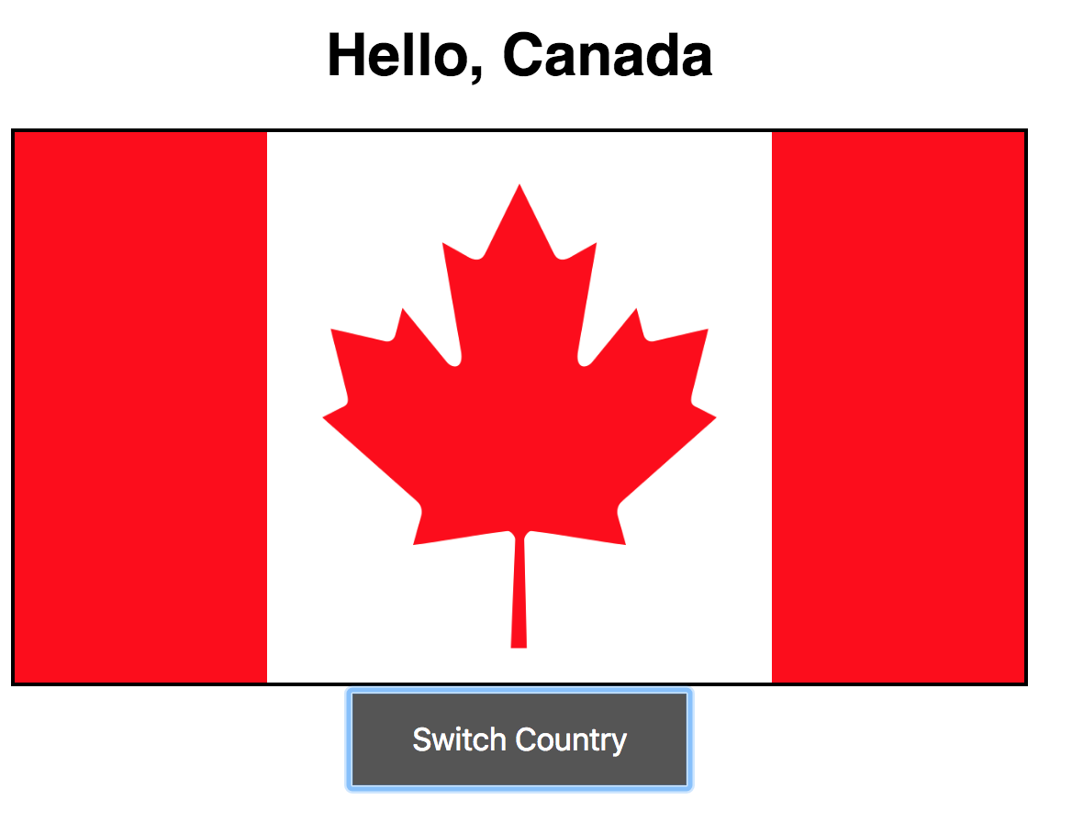
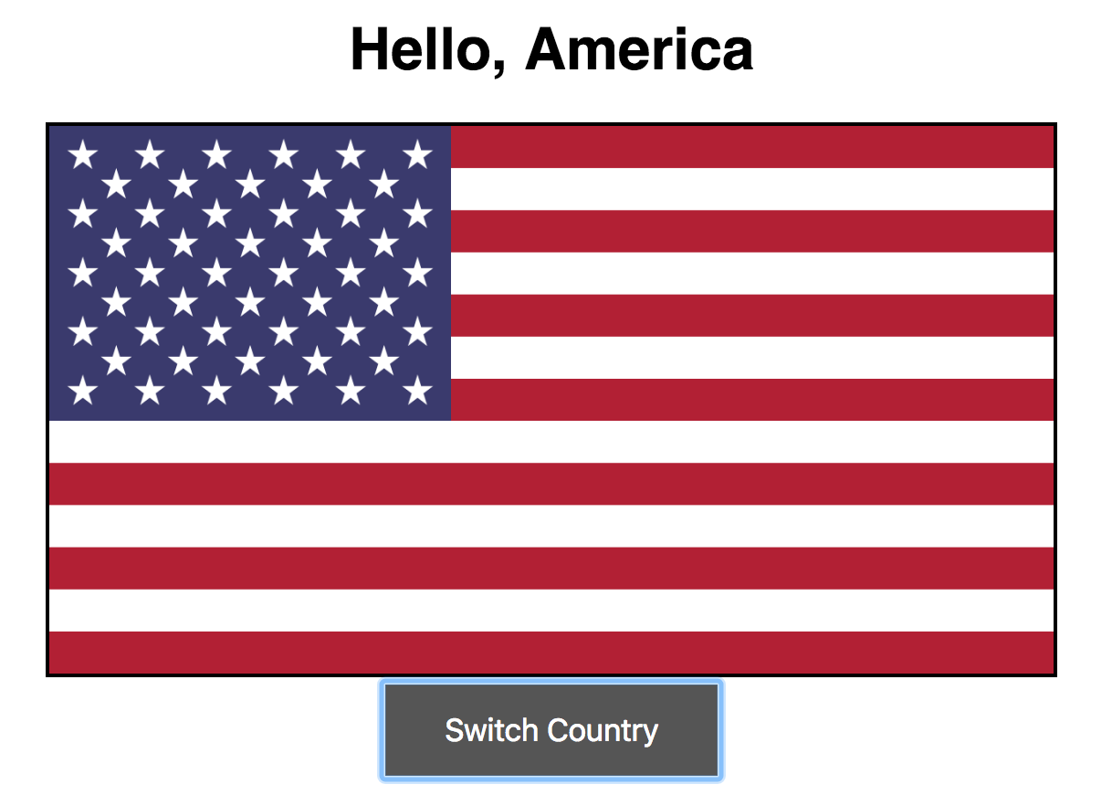
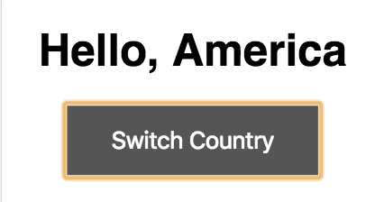
BackstopJS

Slide 45
Screenshot Testing:
Native
View
Loader
Action
Driver
Comparison
Driver

Slide 46
Screenshot Testing:
Native
Android
screenshot-tests-for-android
iOS
iOS
ios-snapshot-test-case
ios-snapshot-test-case

Slide 47
Demo Time:
Screenshot Testing
Android

Slide 48
Enterprise
Percy.io
Flawlessapp.io
Chromatic
Screener.io

Slide 49
Best Practices
Screenshot Names
Component Testing First
Git Media
Standard Test Pyramid

Slide 50
Summary
DOM/CSS Not Enough
Dev = Test
Choose Solution
Build Solution

Slide 51
Page Visual Tests

Slide 52
Responsive Testing
Window Size
DOM/CSS
Transition States
Screenshots

Slide 53
Demo Time:
Responsive Testing
with Selenium

Slide 54
Demo Time:
Native Visual Testing
with
Appium
& Applitools

Slide 55
Enterprise
Applitools
BrowserStack
SauceLabs
SauceLabs
TestObject

Slide 56
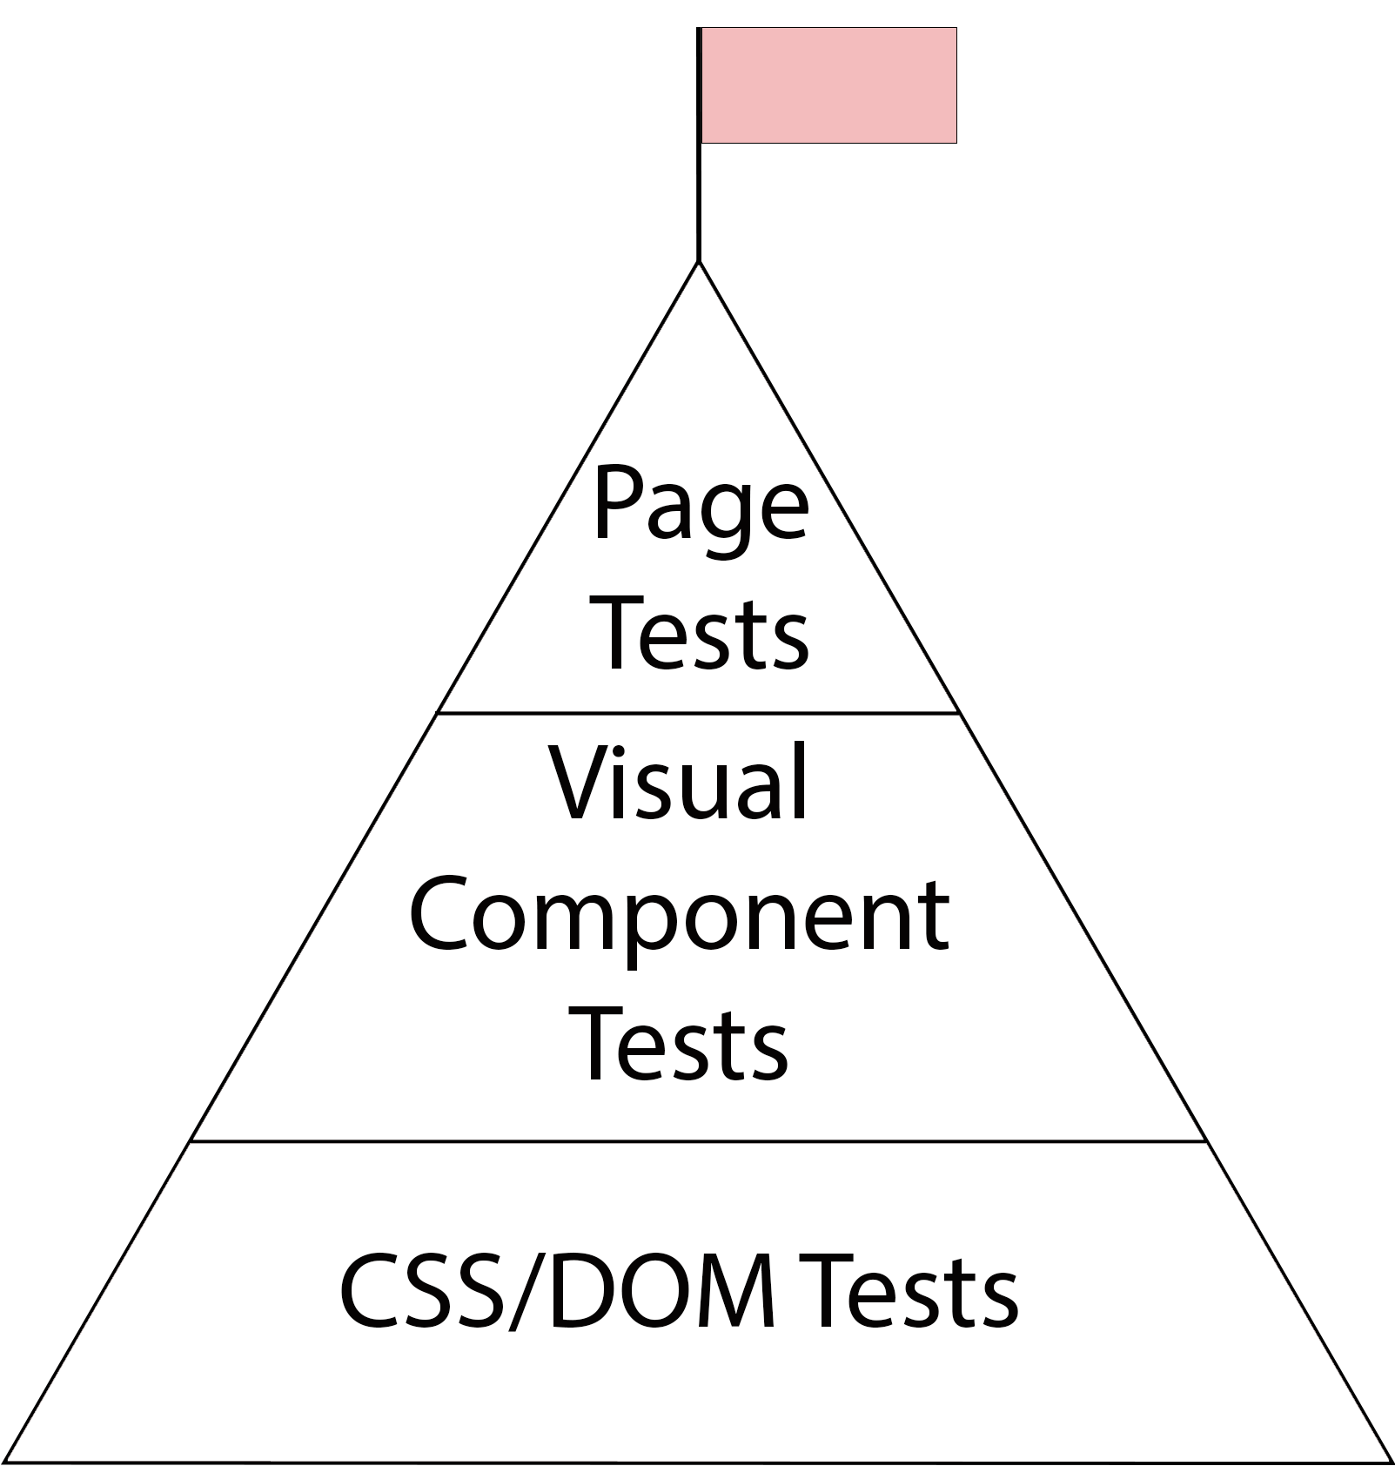

Summit
You
+

Slide 57
Call For Action
Start the Climb
Visual Unit Tests
Visual Component Tests
Visual Page Tests

Slide 58
Q/A

Slide 59
About Speaker
Twitter: @DmitryVinnik
LinkedIn: in/dmitry-vinnik/
Email: dmitry@dvinnik.com

